Slide 1
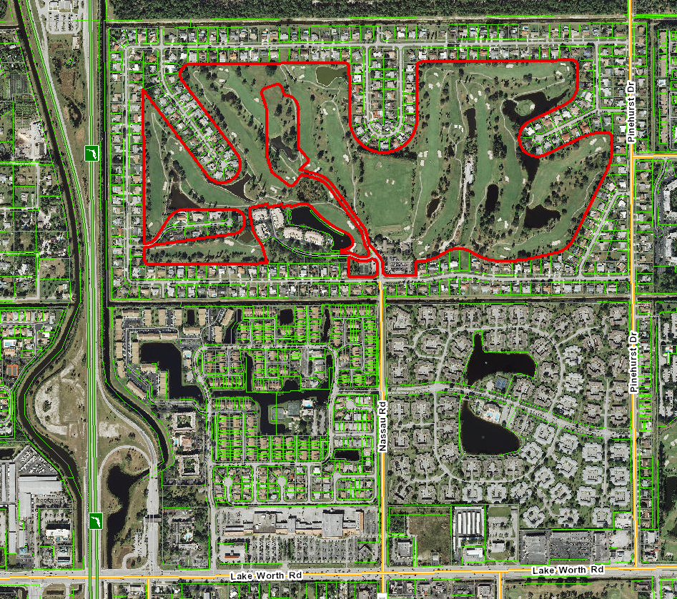
Border of Palm Beach National Civic Association
Shaded Area Is The
Outline of Palm
Beach National
Neighborhood
North
Red Outline is
The Palm Beach
National Golf
Course (143 acres)
As of February 3, 2014

Slide 2
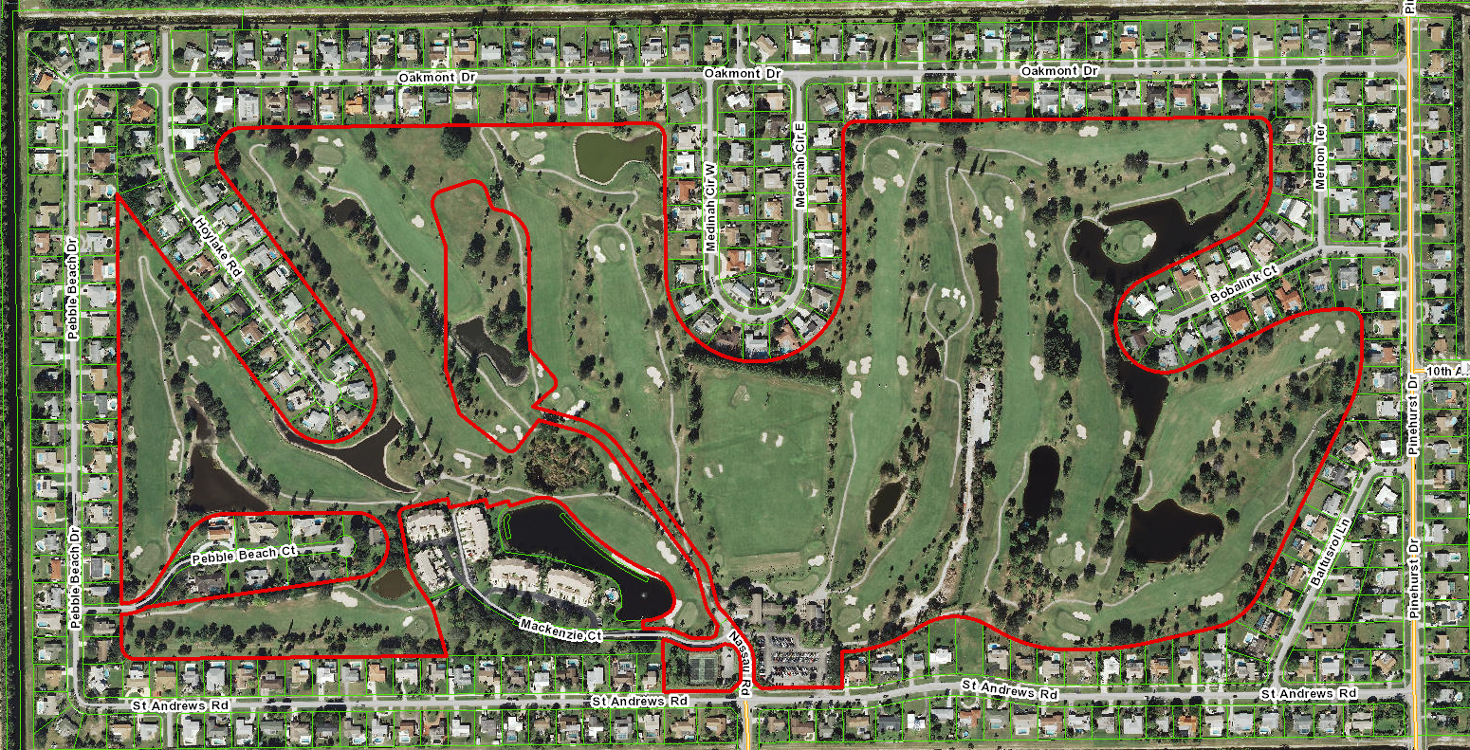
Border of Palm Beach National Civic Association
Close Up of Neighborhood from St. Andrews Road North
North
Red Outline is The Palm Beach National Golf Course (143 acres)
As of February 3, 2014

Slide 3
Border of Palm Beach National Civic Association
Close Up of Neighborhood from St. Andrews Road
South on the East Side Of Pinehurst Only
St. Andrews Road
North
Bridge Drive
Pinehurst Road
Neighborhood Starts from St. Andrews Road
South on the East Side Of Pinehurst Only
Cover Bridge Blvd
Lake Worth Road
As of February 3, 2014

