Slide 1
For Information on Canals Surrounding Our
Neighborhood of Palm Beach National
Please direct all questions to:
Lake Worth Drainage District (LWDD) 13081 Military Trail Delray Beach, FL 33484 Delray Beach & Boca Raton (561) 498-5363 Boynton & West Palm Beach (561) 737-3835 Fax: (561) 495-9694
A Map is Located on the Second Page Below
As of February 3, 2014

Slide 2
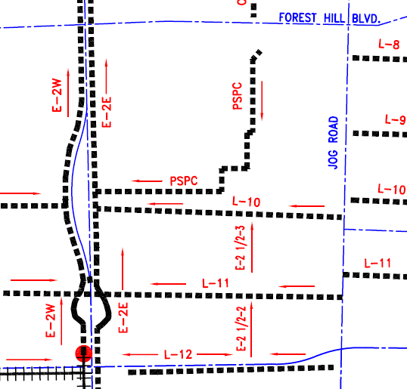
Lake Worth Drainage District (LWDD) Canal Names Surrounding
Palm Beach National Neighborhood and Civic Association
PBNCA Neighborhood In Blue Shade Area
As of February 3, 2014

